Slide 1
Autism Spectrum Disorder (ASD) Services Provider Manual Update:
Medical Necessity Criteria
South Carolina Department of Health and Human Services
Division of Behavioral Health

Slide 2
Disclaimer
All information in this presentation pertains to South Carolina Department of Health and Human Services Healthy Connections (SCDHHS) Medicaid members and that prior to treatment, all members must meet the medical necessity criteria for the requested service.
This training will address the general updates regarding medical necessity determinations for ASD services but can not address all details. For comprehensive policy guidelines, please refer to the full ASD Services provider manual.
Slides will be available following completion of the ASD training series.
Questions regarding specific ABA services are outside the scope of today’s training and should be emailed to
ASDprovider@scdhhs.gov

Slide 3
Summary Policy Update
Effective Sept. 1, 2025, SCDHHS’ ASD Service Provider Manual updated to:
  Support clinical flexibility by allowing comprehensive diagnostic assessments (CDA) to be completed using one of three validated autism diagnostic tools.
  Support physicians in the medical care home, allowing them to use validated instruments within primary care settings, to manage their own patients, prevent unnecessary referrals/ duplicate assessments, shorten wait time to early intervention and improve continuity of medical care.
  Optimize Presumptive Eligibility for Applied Behavior Analysis (ABA) therapy based on ASD risk while awaiting a CDA and diagnosis of ASD.
  Align ASD diagnostic /eligibility requirements among state partners (SCDHHS, BabyNet and Department of Behavioral Health and Developmental Disabilities, Office of Intellectual and Development Disabilities (OIDD) and Department of Education (DOE)) to eliminate the need for duplicate diagnostic evaluations for members with a pre-existing ASD determination from our state partners.

Slide 4
Objectives
To differentiate the three pathways that can be used to determine medical necessity for ASD services
  Comprehensive Diagnostic Assessment (CDA)
  Medical-care-home autism assessment (MCH)
  Presumptive eligibility assessment for ABA Therapy
Clarify documentation requirements to support a valid diagnosis of ASD and eligibility for ABA therapy

Slide 5
  Three Different Pathways

Slide 6
Objectives
CDA
Medical-Care-Home Autism Assessment
Presumptive Eligibility Assessment for ABA Therapy

Slide 7
Comprehensive Diagnostic Assessment
The “comprehensive diagnostic assessment” replaces the “comprehensive psychological evaluation”, indicating additional professionals and tools considered valid to complete a CDA.
Licensed physicians are permitted to directly administer and complete the CDA
  Licensed psychologist
  Licensed psychoeducational specialist
  Licensed physician practicing within their scope; including but not limited to pediatricians, developmental & behavioral pediatricians, psychiatrists, neurologists, family medicine physicians
One of the following validated tools are required to support DSM criteria for ASD:
  Autism Diagnostic Interview, Revised (ADI-R)
  Autism Diagnostic Observation Schedule (ADOS)
  Childhood Autism Rating Scale (CARS-ST/HF)
“Measure of intelligence” has been replaced by “A standardized cognitive or developmental measure”
Clear language indicates that results and measures of valid prior autism and psychological evaluations must be included in the CDA and we do not require them to be repeated to confirm a medical diagnosis of ASD: including, IDEA designations of ASD and OIDD eligibility under the ASD category

Slide 8
CDA (cont.)
Summary of Updates
  Physicians can administer a CDA.
  Multiple autism diagnostic tools are considered valid. An ADOS may be clinically helpful, but the ADOS is not required to make an ASD diagnosis.
  Diagnostic and Statistical Manual (DSM) “E” criteria can be addressed using a standardized cognitive or developmental measure. A formal “IQ score” is not required. There is no list of approved measures. The validity of the tool should be within clinician’s scope and clearly addressed in their clinical documentation.
  Multidisciplinary evaluations through our state partners that resulted in eligibility/designations of ASD are considered valid; irrespective of the date of the determination, measures used, or clinician type used to reach that determination.
  Policy does not support repeat testing to confirm medical necessity
  The report for a comprehensive diagnostic assessment should be as long as necessary to ethically and appropriately address the referral question and related differential diagnosis.

Slide 9
CDA (cont.)
Summary of Clarifications
  Adaptive measures were not required prior to Sept. 1, 2025, and are still not required for an ASD diagnosis.
  Virtual/telehealth evaluations were not valid prior to Sept. 1, 2025, and are still not valid for an ASD diagnosis.
  The physician, psychologist, or LPES completing an initial CDA must administer required assessments themselves. They can not sign off on a CDA administered by another provider.
  Validated behavioral rating scales are strongly encouraged based on the child’s clinical presentation and the clinician’s need to address the differential diagnosis. We do not have specific requirements.
  While the goal of SCDHHS is to accept valid diagnoses from our state partners, our partners at OIDD and DOE must make eligibility determinations based on the child’s needs for their specific services. As a result, the CDA can support that determination, but it has never guaranteed a school-based IDEA ASD determination or OIDD eligibility under the ASD category.
  A member with an ASD diagnosis from a CDA completed outside of a developmental evaluation center (DEC) should not be referred to a DEC to confirm an autism diagnosis or to provide care coordination or family counseling. These functions are expected elements of the member’s comprehensive diagnostic assessment.

Slide 10
  CDA
  Medical-Care-Home Autism Assessment
  Presumptive Eligibility Assessment for ABA Therapy

Slide 11
Medical-Care-Home Autism Assessment
To support continuity of care of autistic children in the medical care home, by allowing physicians to administer focused autism assessments and diagnose ASD in two clinical situations:
    Medical confirmation of prior ASD diagnosis
    Initial diagnosis of toddler with unequivocal ASD presentation

Slide 12
Medical-Care-Home Autism Assessment (cont.)
To support continuity of care of autistic children in the medical care home, Physicians can confirm a prior ASD diagnosis and manage the patient’s care without subspecialty evaluations.
1. Medical Confirmation of Prior ASD Diagnosis
  Any licensed physician in the medical care home can confirm an ASD diagnosis, ensure the medical standard of care has been addressed, coordinate referrals to subspecialists and therapists.
  Valid Prior Evaluations
    DOE: IDEA classification of ASD
    BHDD-OIDD: ASD Eligibility Category
    Out-of-state diagnosis that meets CDA criteria
      Administered directly by physician (MD/DO), psychologist (PhD/PsyD), or LPES equivalent
      Administered in-person (virtual diagnostic evaluations are not valid)
      Must include ADOS/ADI/CARS + cognitive or developmental assessment
    Child will not be referred for CDA or to a DEC for ASD diagnosis

Slide 13
Medical-Care-Home Autism Assessment (cont.)
To support continuity of care of autistic children in the medical care home, Physicians can confirm a prior ASD diagnosis and manage the patient’s care without subspecialty evaluations.
1. Medical Confirmation of Prior ASD Diagnosis
  Any licensed physician in the medical care home can confirm an ASD diagnosis, ensure the medical standard of care has been addressed, coordinate referrals to subspecialists and therapists.
  Assessment requires
      Documentation of review of prior evaluation
      Completion of DSM checklist within clinical note AND the SCDHHS physician diagnostic form
      Standard of care referrals and coordination of care
      Confirmation with family/caregiver of understanding that a medical-care-home assessment for ASD is valid for complete diagnosis for Medicaid, and a referral to a DEC is not indicated. A DEC is not required to confirm an autism diagnosis.
  Succinct Visit (Compared to CDA)
      Time: 1-3 hours depending on clinical needs
      Billing: No new guidance. Should be billed through standard clinical E&M codes
    Child will not be referred for CDA or to a DEC for ASD diagnosis

Slide 14
Medical-Care-Home Autism Assessment
To support continuity of care of autistic children in the medical care home, Physicians can administer focused autism assessments and diagnose ASD in medical-care home settings in two clinical situations:
    Medical confirmation of prior ASD diagnosis
    Initial diagnosis of toddler with unequivocal ASD presentation

Slide 15
Medical-Care-Home Autism Assessment (cont.)
To support continuity of care of autistic children in the medical care home, Physicians can make initial ASD diagnoses and manage the patient’s care without subspecialty evaluations.
2. Initial diagnosis of a toddler with unequivocal presentation
Physician with verified, formal training in the RITA-T or STAT, can diagnose autism for primary Medicaid Members, 18 to 36 months of age, who have unequivocally high-risk presentations of Autism, and whose caregivers are ready for diagnosis.
  Physician Office Assessment requires
    Clinical/autism interview reviewing medical and developmental history
    Detailed documentation of physician-administered RITA-T with score ≥ 18 OR STAT with score ≥ 3.0
    Detailed documentation of standard of care developmental screener or cognitive / developmental assessment to support DSM “E” criteria.
    Completion of DSM checklist within clinical note and completion of SCDHHS physician diagnostic form
    Standard of care referrals
    Confirmation with family/caregiver of understanding that a medical-care-home assessment for ASD is valid for complete diagnosis for Medicaid, and a referral to a DEC is not indicated. A DEC is not required to confirm an autism diagnosis.
    Child will not be referred for CDA or to a DEC for ASD diagnosis

Slide 16
Medical-Care-Home (MCH) ASD Assessment
Summary of Clarifications
  This pathway is for children with Primary Medicaid only. It is the Physician’s responsibility to ensure any assessment meets the medical necessity requirements of the child’s primary insurer.
  This pathway is built on the premise of supporting an established physician-patient-family relationship, and the physician’s ability to ensure their patient continues to receive the medical standard of care. Only physicians in a medical-care-home capacity can complete the MCH assessment and use the respective form.
  These pathways were developed and reviewed with the support of our MCO partners.
  Physicians are not expected to interpret any prior tests on a valid prior assessment but instead focus on the ultimate IDEA determination or Eligibility category, and use their clinical judgement to document prior efforts and refer patient to appropriate services.
  Physicians are not required to offer these assessments. Members’ caregivers should inquire with their medical-care-home regarding their Primary-care-Physician’s ability to administer MCH ASD Assessments.
  A member with a MCH assessment will not be referred to a DEC to confirm an autism diagnosis, insurance requirements, provide care coordination, or family counseling.

Slide 17
  Comprehensive Diagnostic Assessment
  Medical-Care-Home Autism Assessment
  Presumptive Eligibility Assessment for ABA Therapy

Slide 18
Presumptive Eligibility Assessment for ABA Therapy
Physicians with verified, formal training in the RITA-T or the STAT can refer a child to ABA therapy without a diagnosis of autism, if the child is found to be at risk for autism on a validated secondary autism screener
Physician Office Assessment requires
  Brief review of risk factors and caregiver concerns for development or related autism symptoms
  Documentation of Physician administered RITA-T with score ≥ 12 OR STAT with score ≥ 2.0
  Completion of SC DHHS Presumptive Eligibility Form and Standard of care referrals
Confirmation with family/caregiver of understanding that
  Presumptive Eligibility for ABA therapy is NOT a medical diagnosis of ASD, but an agreement to support ABA therapy due to a child’s documented risk for development of ASD. ­
  Presumptive eligibility for ABA services does not automatically extend or affect eligibility for state-specific early intervention services, school-based services through the DOE, or services through OIDD. Each entity maintains its own eligibility process. ­
  To ensure ongoing eligibility for ABA services, their child must obtain a formal assessment that documents a DSM-supported diagnosis of autism spectrum disorder, prior to their child’s 6th birthday.
Brief Visit (Compared to CDA or Medical-Care-Home Autism Assessment)
  Time: 1-2 brief outpatient visits
  Billing: No new guidance. Should be billed through standard clinical E&M codes
    Referral for CDA or to a DEC for evaluation is REQUIRED

Slide 19
Presumptive Eligibility Assessment for ABA Therapy
Summary of Clarifications
  This pathway is built on the premise of supporting an established physician-patient-family relationship, and the physician’s ability to ensure their patient continues to receive the standard of care. Only physicians in a medical-care-home capacity can complete the presumptive eligibility assessment and use the respective form.
  The standard of care per the American Academy of Pediatrics (AAP), has always been to engage with the state’s early intervention Program for further evaluation of suspected delays. Our policy supports this and requires physician coordination with BabyNet. We are currently working with our BabyNet colleagues to streamline presumptive eligibility assessments completed in the medical care home.
  The determination must be made when the child is between 18-36 months of age and is considered valid until the child reaches their 6th birthday. This ensures that even a child determined eligible at 36 months, will have adequate time to navigate a Subspecialty waitlist and obtain a diagnosis.
  Physicians are not required to offer these assessments. Members’ caregivers should inquire with their medical-care-home regarding their Primary-care-Physician’s ability to administer presumptive eligibility assessments for ABA therapy.
  A member with presumptive eligibility for ABA therapy MUST be referred for an appropriate assessment and have valid documentation of medical necessity criteria for an ASD diagnosis prior to their 6th birthday

Slide 20
Comparing Two Medical Care Home Pathways
Medical-Care-Home Assessment
  Physician can diagnose ASD and refer to all ASD services, without subspecialty evaluation.
  Valid when member:
    Has prior, valid ASD diagnosis, OR
    Is medically uncomplicated, 18–36- months of age at time of determination, with unequivocal ASD symptoms and very high-risk scores on one of two validated secondary autism screening tools.
  Caregivers are ready for diagnosis
  Requires completion SC DHHS physician diagnostic form
  Caregiver or family understands that they will NOT be referred for a CDA, that MCH Assessment is sufficient.
  Results in ICD-10 Code: F84.0 autism spectrum disorder
Presumptive Eligibility Assessment for ABA Therapy
  Physician is NOT diagnosing Austism, but making a risk determination to support ABA therapy
  Valid regardless of patient complexity or caregiver readiness of diagnosis
  Requires completion of SCDHHS presumptive eligibility form
  Counseling required that caregiver/family understands this is a risk assessment, with concern significant enough to begin ABA, but this is not a diagnosis.
  Child MUST be referred for a CDA, with formal diagnosis documented prior to their 6th birthday, or ABA services will lapse.
  Does NOT confer automatic eligibility for ASD services through any state partner.
  DOES NOT Result in F84.0 ICD-10 Code
    This is NOT an ASD Diagnosis. This pathway is an acknowledgement of a RISK for autism that SC DHHS has determined meets conditional medical necessity of ABA therapy. Any ICD-10 code relevant to the child’s developmental delays is sufficient for medical and ABA prior authorization documentation requirements

Slide 21
  Brief Break for Questions

Slide 22
  2. Documentation Expectations

Slide 23
Documentation Expectations
Before 9/1/2025 | Current Policy
Comprehensive Psychological Assessment Completed in-person by a Psychologist, DBP, LPES ADOS Intelligence Measure DSM Checklist with severity levels F84.0 ICD-10 Code Formal and comprehensive evaluation report | Comprehensive Diagnostic Assessment: Completed in-person by a Physician, Psychologist, LPES ADOS, ADI-R, CARS-ST/CARS-HF Cognitive or developmental measure DSM Checklist with severity levels F84.0 ICD-10 Code Formal and comprehensive evaluation report *Valid measures from prior evaluations must be used in lieu of administering new/additional measures
 | Medical-Care-Home Assessment Completed by a physician in a medical care home setting Detailed test measures of prior evaluation OR results of Physician administered RITA-T with score ≥ 18 OR STAT with score ≥ 3.0 and cognitive screener DSM checklist with severity levels F84.0 ICD-10 Code SCDHHS Primary Care Physician Documentation Form completed Copy of complete prior evaluation attached, Clinical Note, with appropriate elements integrated where necessary * Does NOT require an ADOS, Will not look like a traditional Comprehensive Report
 | Presumptive Eligibility Assessment Completed by a physician in a medical care home setting Physician administered RITA-T with score ≥ 12 OR STAT with score ≥ 2.0 DO NOT INCLUDE F84.0 ICD-10 Code. Any code documenting ASD risk or developmental delay is appropriate. SCDHHS Presumptive Eligibility for ABA Therapy Form completed Brief clinical note * Does NOT require an ADOS or DSM Checklist, Will not look like a traditional Comprehensive Report

Slide 24
  Documenting a Prior Evaluation

Slide 25
In Practice
A 5-year-old patient comes to clinic. Caregiver reports that OIDD said the child was autistic. Caregiver has the complete evaluation in hand and is seeking medical guidance and referral to ABA therapy.
Plan:
Confirm ASD diagnosis with review of evaluation
Copy comprehensive evaluation into EMR for child’s record
Add critical testing measures to your clinical note
Place necessary referrals
Complete primary care physician diagnostic form

Slide 26
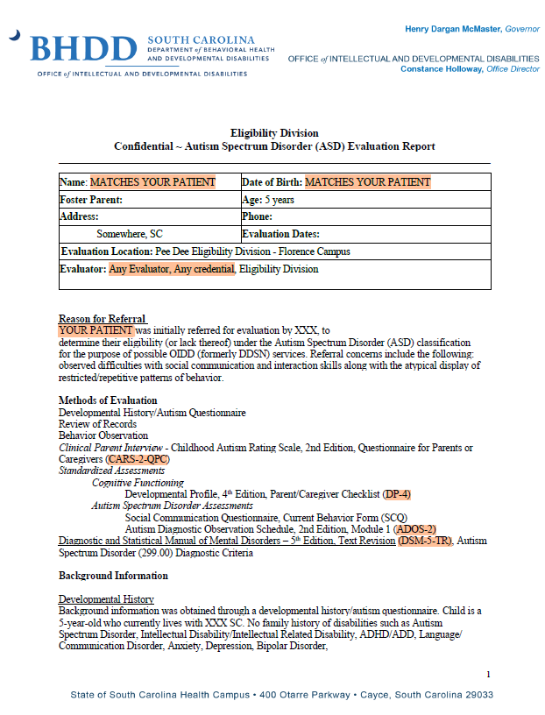
In Practice
A 5-year-old patient comes to clinic. Caregiver reports that OIDD said the child was autistic. Caregiver has that evaluation and is seeking medical guidance and referral to ABA therapy.
Plan
Confirm evaluation matches your patient
Identify ASD tools used to support diagnosis
Remember: This evaluation was considered valid by a partner state agency for diagnosis, eligibility and services. Interpretation of the validity of evaluator or administered tools is not required.
Any Date

Slide 27
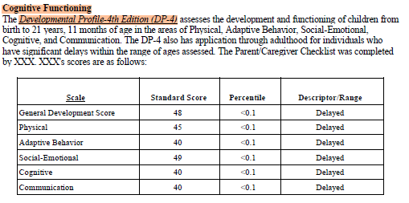
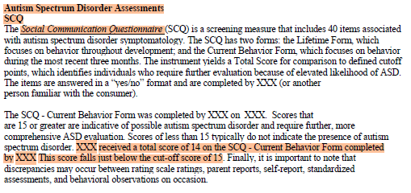
In Practice
A 5-year-old patient comes to clinic. Caregiver reports that OIDD said the child was autistic. Caregiver has that evaluation and is seeking medical guidance and referral to ABA therapy.
Plan
Include specific results in your clinical documentation
Remember: This evaluation was considered valid by a partner state agency for diagnosis, eligibility and services. Interpretation of the validity of evaluator or administered tools is not required.

Slide 28
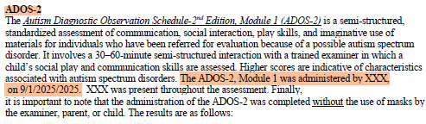
In Practice
A 5-year-old patient comes to clinic. Caregiver reports that OIDD said the child was autistic. Caregiver has that evaluation and is seeking medical guidance and referral to ABA therapy.
Plan
Include specific results in your clinical documentation
Remember: This evaluation was considered valid by a partner state agency for diagnosis, eligibility and services. Interpretation of the validity of evaluator or administered tools is not required.
Module 1 (Few Words) | Score | Cutoff
Social Affect | 11
RRB’s | 6
Overall Total | 17 | 11 ( Autism Spectrum) , 16 ( Autism)
ADOS Classification: Autism
ADOS-2 Comparison Score: 6 – Indicating Moderate Level of ASD Symptoms

Slide 29
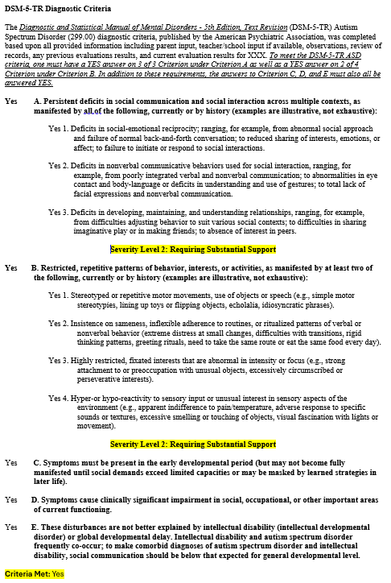
In Practice
A 5-year-old patient comes to clinic. Caregiver reports that OIDD said the child was autistic. Caregiver has that evaluation and is seeking medical guidance and referral to ABA therapy.
Plan
Review checklist to help document severity levels
Remember: This evaluation was considered valid by a partner state agency for diagnosis, eligibility and services. Interpretation of the validity of evaluator or administered tools is not required.

Slide 30
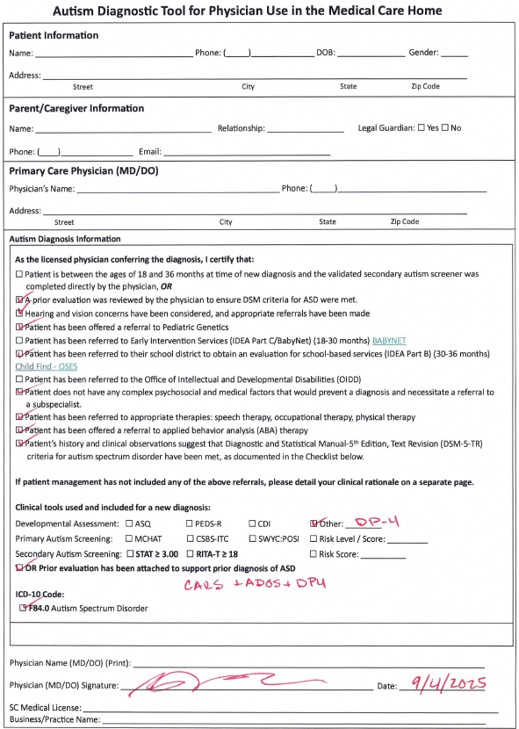
In Practice
Using the Autism Diagnostic Tool for Physician Use in The Medical Care Home
“The Autism Diagnostic Tool for Physician Use in Medical Care Home” serves as a standard summary of care guide for expected referrals that physicians should place and/or discuss with the child’s caregiver. It can be used by caregivers, families, or therapists to quickly clarify ASD diagnosis and tools used to support a DSM diagnosis.
Form MUST be accompanied by a copy of the MCH Assessment Clinical Note AND a copy of the completed prior evaluation used to support diagnosis; OIDD, DOE, or other evaluation
Completion of this form, and ensuring the parent/caregiver is given a copy of the form and accompanying documentation, IS REQUIRED when confirming or making a diagnosis of ASD and referring to ABA therapy

Slide 31
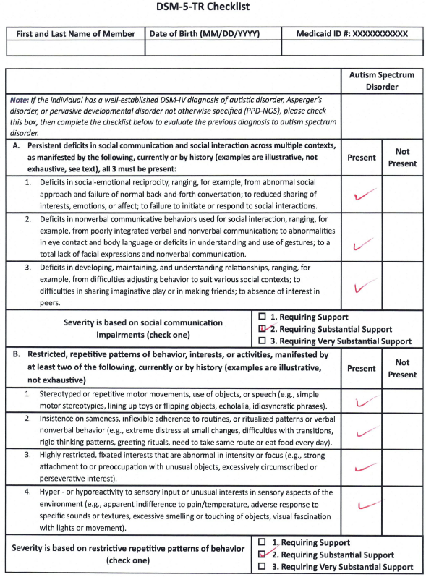
In Practice
Using the Autism Diagnostic Tool for Physician Use in The Medical Care Home
“The Autism Diagnostic Tool for Physician Use in Medical Care Home” serves as a standard summary of care guide for expected referrals that physicians should place and/or discuss with the child’s caregiver. It can be used by caregivers, families, or therapists to quickly clarify ASD diagnosis and tools used to support a DSM diagnosis.
Form MUST be accompanied by a copy of the MCH Assessment Clinical Note AND a copy of the completed prior evaluation used to support diagnosis; OIDD, DOE, or other evaluation
Completion of this form, and ensuring the parent/caregiver is given a copy of the form and accompanying documentation, IS REQUIRED when confirming or making a diagnosis of ASD and referring to ABA therapy

Slide 32
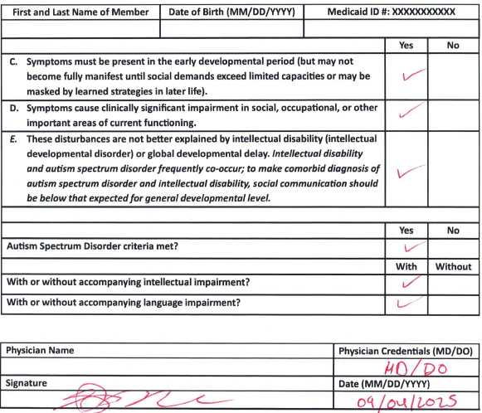
In Practice
Using the Autism Diagnostic Tool for Physician Use in The Medical Care Home
“The Autism Diagnostic Tool for Physician Use in Medical Care Home” serves as a standard summary of care guide for expected referrals that physicians should place and/or discuss with the child’s caregiver. It can be used by caregivers, families, or therapists to quickly clarify ASD diagnosis and tools used to support a DSM diagnosis.
Form MUST be accompanied by a copy of the MCH Assessment Clinical Note AND a copy of the completed prior evaluation used to support diagnosis; OIDD, DOE, or other evaluation
Completion of this form, and ensuring the parent/caregiver is given a copy of the form and accompanying documentation, IS REQUIRED when confirming or making a diagnosis of ASD and referring to ABA therapy

Slide 33
In Practice
Using Autism Diagnostic Tool for Physician Use in Medical Care Home
“The Autism Diagnostic Tool for Physician Use in Medical Care Home” serves as a standard summary of care guide for expected referrals that physicians should place and/or discuss with the child’s caregiver. It can be used by caregivers, families, or therapists to quickly clarify ASD diagnosis and tools used to support a DSM diagnosis.
Form MUST be accompanied by a copy of the MCH Assessment Clinical Note AND a copy of the completed prior evaluation used to support diagnosis; OIDD, DOE, or other evaluation
Completion of this form, and ensuring the parent/caregiver is given a copy of the form and accompanying documentation, IS REQUIRED when confirming or making a diagnosis of ASD and referring to ABA therapy

Slide 34
  Documenting a MCH Initial Diagnosis

Slide 35
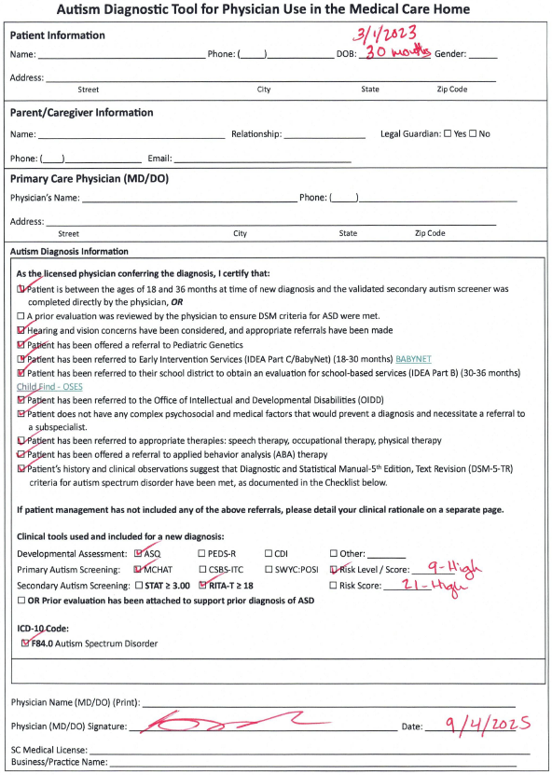
In Practice
To document initial diagnosis using a secondary autism screener
“The Autism Diagnostic Tool for Physician Use in Medical Care Home” serves as a standard summary of care and guide for expected referrals that physicians should place and/or discuss with the child’s caregiver. It can be used by caregivers, families, or therapists to quickly clarify ASD diagnosis and tools used to support a DSM diagnosis.
Form MUST be accompanied by a copy of the clinical note from the medical care home assessment AND a copy of the completed RITA-T and/or STAT protocol used to support diagnosis.
Completion of this form, and ensuring the parent/caregiver is given a copy of the form and accompanying documentation, IS REQUIRED when confirming or making a diagnosis of ASD and referring to ABA therapy

Slide 36
In Practice
Using Autism Diagnostic Tool for Physician Use in Medical Care Home
“The Autism Diagnostic Tool for Physician Use in Medical Care Home” is intended to serve as a standard summary of care and guide for expected referrals that physicians should place or discuss with the child’s caregiver. It can be used by caregivers, families, therapists to quickly clarify ASD diagnosis and tools used to support DSM criteria.
Form MUST be accompanied by a copy of the clinical note from the medical care home assessment AND a copy of the completed prior evaluation used to support diagnosis; OIDD, DOE, or other evaluation
Form should ALWAYS be accompanied by a copy of the clinical note from the Medical Care Home Assessment AND a copy of the completed prior evaluation used to support diagnosis; BHDD-OIDD, SCDOE, or other evaluation

Slide 37
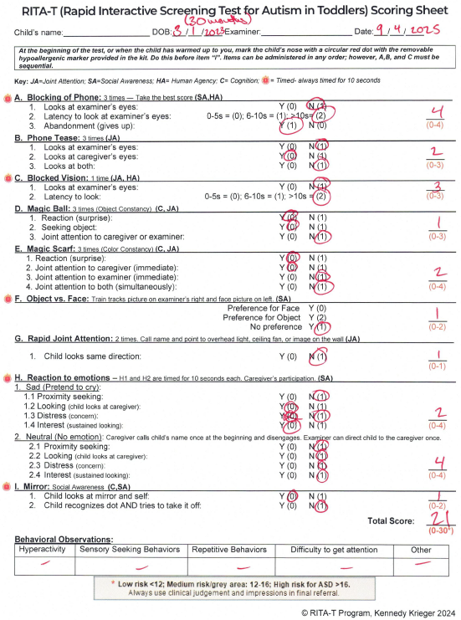
In Practice
Completed RITA-T Protocol
High-Risk

Slide 38
  Documenting Presumptive Eligibility for ABA Therapy

Slide 39
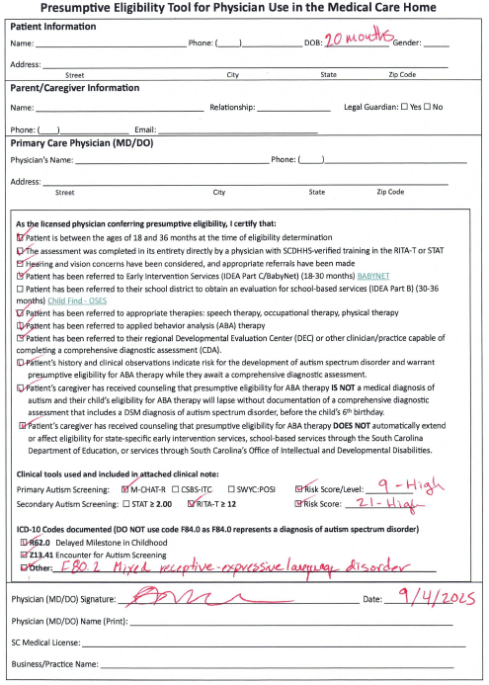
In Practice
To document presumptive eligibility for ABA therapy
“The Presumptive Eligibility Tool for Physician Use in Medical Care Home” serves as a standard summary of care guide for expected referrals that physicians should place and/or discuss with the child’s caregiver. It can be used by caregivers, families, or therapists to quickly clarify ASD risk and tools used to support referral to ABA therapy
Form MUST be accompanied by a copy of the clinical note from the presumptive eligibility assessment AND a copy of the completed RITA-T protocol used to support eligibility.
Completion of this form, and ensuring the parent/caregiver is given a copy of the form and accompanying documentation, IS REQUIRED when referring to ABA therapy

Slide 40
In Practice
Completed RITA-T Protocol
High-Risk

Slide 41
Documentation Expectations for ABA Providers
Policy as of 9/1/2025
Comprehensive Diagnostic Assessment A CDA is considered valid for all ASD services, including ABA Therapy, when the member has a comprehensive formal report that indicates the assessment was completed in-person, directly by a physician/psychologist/LPES licensed in South Carolina, who directly administered the ADOS/ADI-R/CARS-ST/CARS-HF* and a cognitive or developmental measure*, completed a DSM checklist with severity levels, and gave a diagnosis of ASD represented by F84.0 ICD-10 Code. *Measures from valid prior confirmatory evaluations must be used in lieu of administering new/additional measures.
Medical-Care-Home Assessment A diagnosis of ASD from the medical care home is considered valid to support all medically necessary ASD services, including ABA therapy, when the member has clinical documentation from a physician that includes the following THREE documents: Brief Clinical report that details test measures of prior evaluation OR results of physician-administered RITA-T with score ≥ 18 OR STAT with score ≥ 3.0 and cognitive screener, DSM checklist with severity levels, F84.0 ICD-10 Code Completed SCDHHS “Autism Diagnostic Tool for Physician Use in the Medical Care Home” Form Copy of complete prior evaluation or secondary screener protocol * Does NOT require an ADOS, Will not look like a traditional Comprehensive Report
Presumptive Eligibility Assessment For ABA Therapy A referral to ABA therapy based on risk for ASD, WITHOUT a diagnosis of autism is considered valid to support medically necessary ABA therapy when the member has been determined “At-Risk” for ASD by a physician with verified, formal training in the STAT or the RITA-T. This pathway requires the clinical documentation to include the following THREE documents: Clinical note that details the physician-administered RITA-T with score ≥ 12 OR STAT with score ≥ 2.0, as well as any ICD-10 code documenting ASD risk or developmental delay. The ICD-10 code of F84.0 for ASD is NOT appropriate. This is not an ASD diagnosis Completed SCDHHS presumptive eligibility tool for physician use in the medical care home Copy of completed RITA-T or STAT protocol * Does NOT require an ADOS or DSM checklist, Will not look like a traditional comprehensive report

Slide 42
This presentation was designed to enhance understanding of the Medicaid standards regarding the ASD Policy Manual updates. Please review the ASD Services Provider Manual and the Administrative and Billing Manuals for detailed guidance.
Questions?
ASDProvider@scdhhs.gov

